Slide 1
Data Science Overview
Erjia Yan, with inputs from Weimao Ke

Slide 2
A hundred people will have a hundred definitions of Data science…
Discipline
even CCI has two DS tracks…
my own background
Career path
industry’s take on DS
academic research
who is ahead of whom?

Slide 3
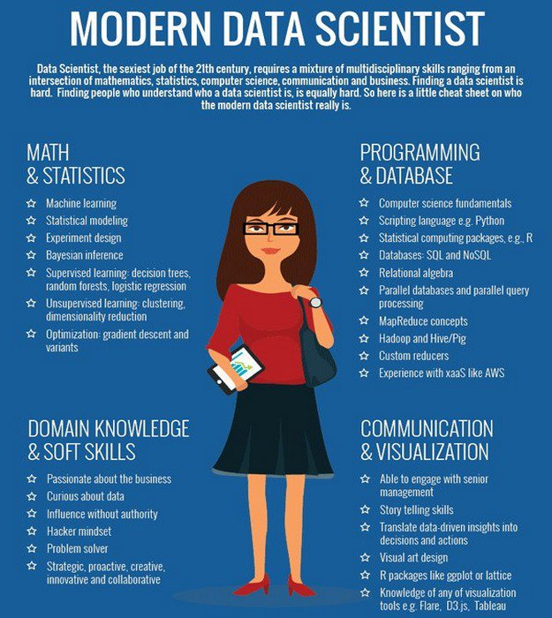
Data Science
What skills do we need for Data Science/science?

Slide 4
data and biases
Trash in trash out
Provenance of data
Time sensitivity
P hacking
Cherry picking
Data driven not question driven
Trust the system
Correlation issues
Lack of context to understand the data

Slide 5
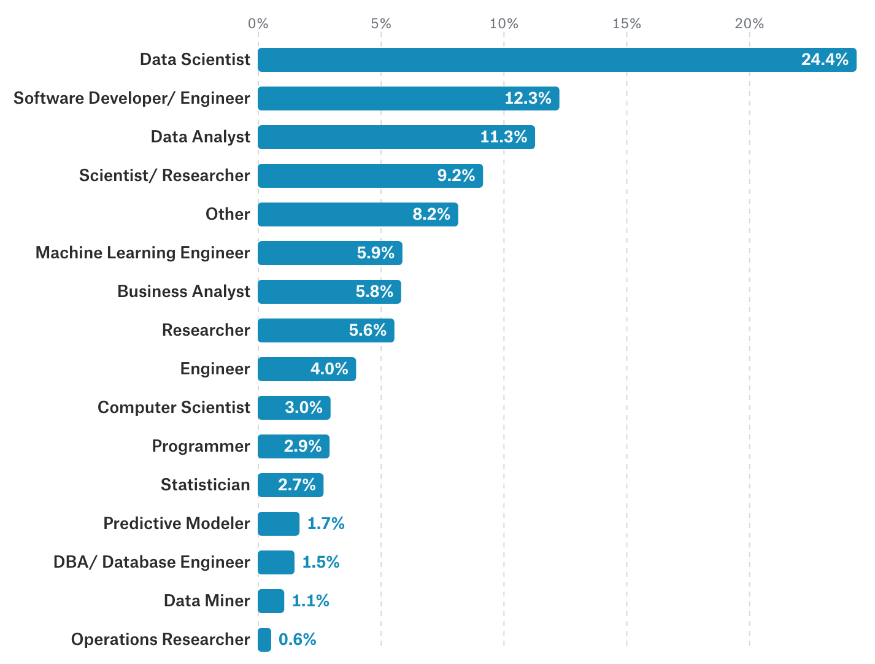
Kaggle 2017 Survey
Job Titles

Slide 6
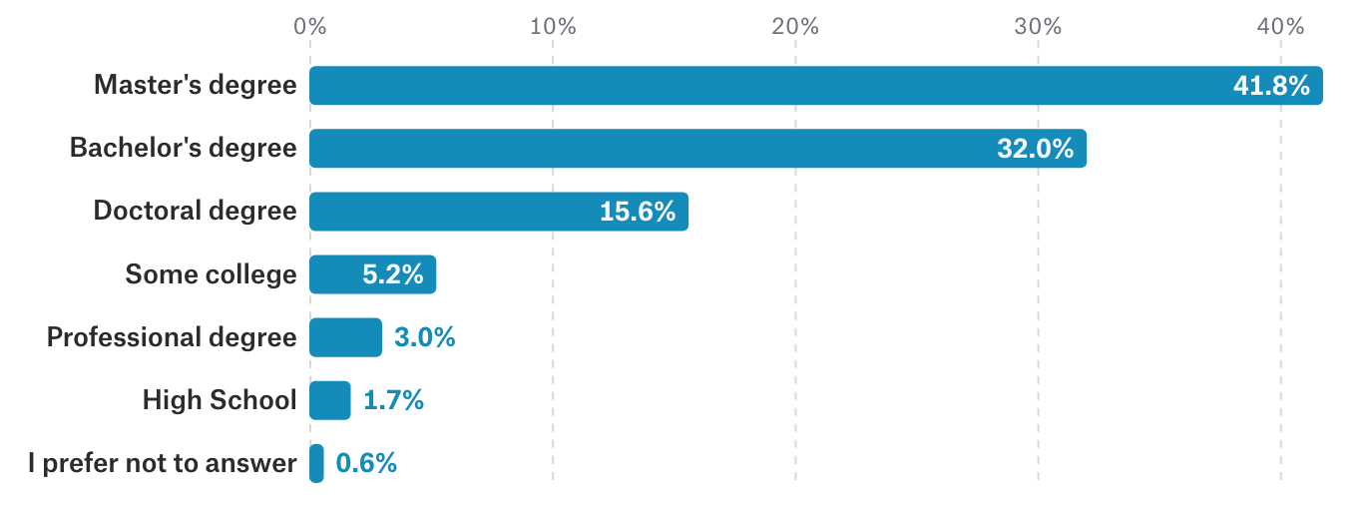
Kaggle 2017 Survey
Education

Slide 7
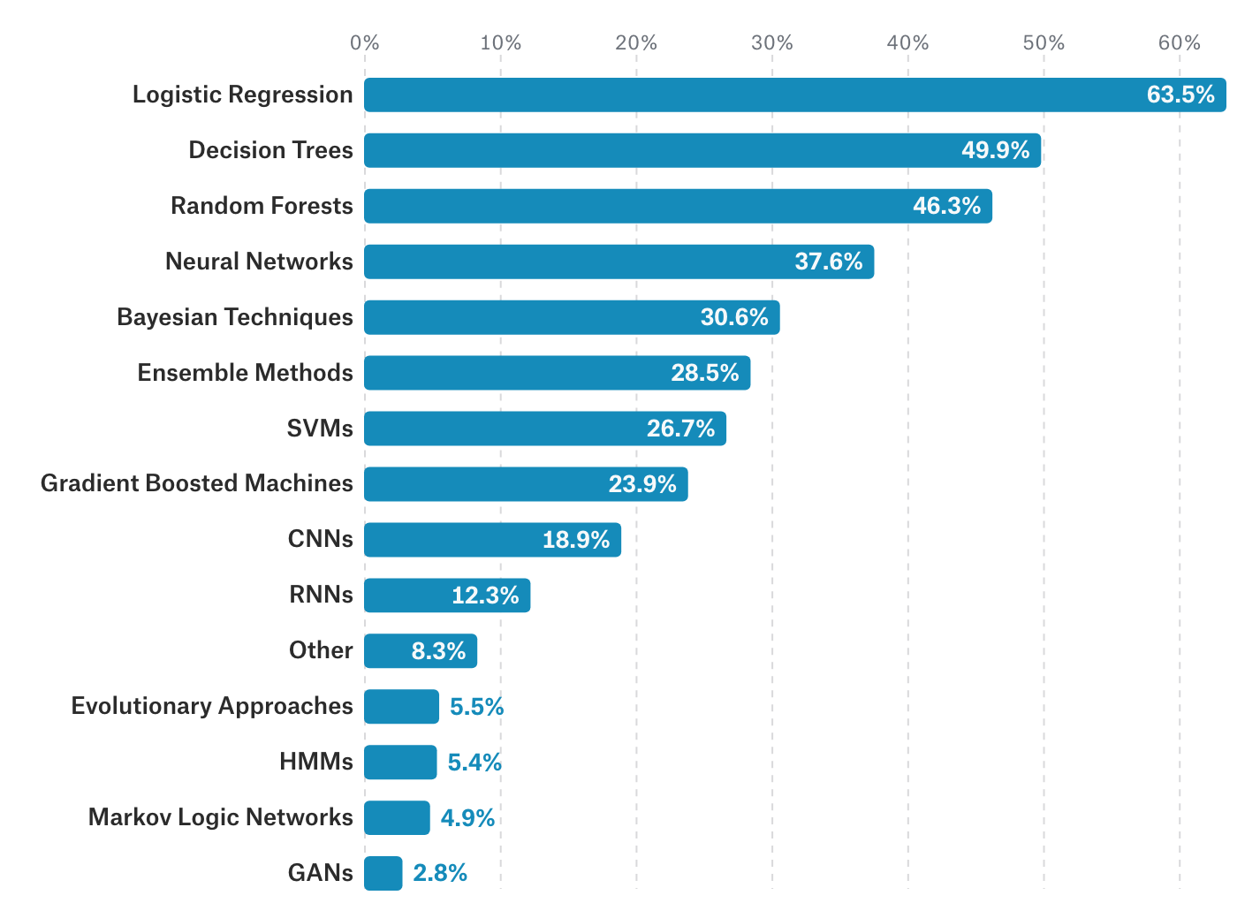
Kaggle 2017 Survey
Methods

Slide 8
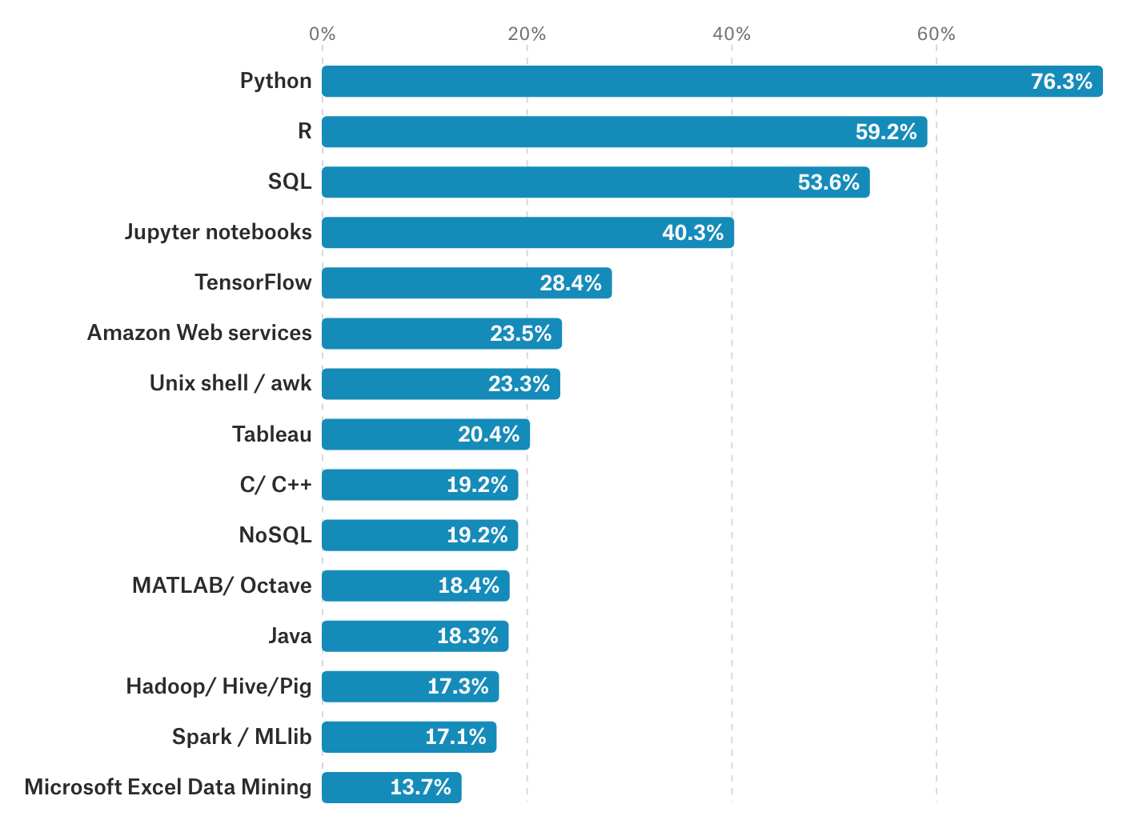
Kaggle 2017 Survey
Tools

Slide 9
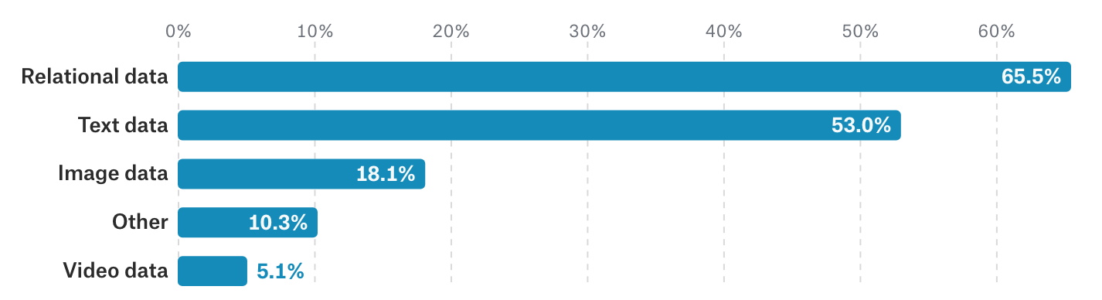
Kaggle 2017 Survey
Data

Slide 10
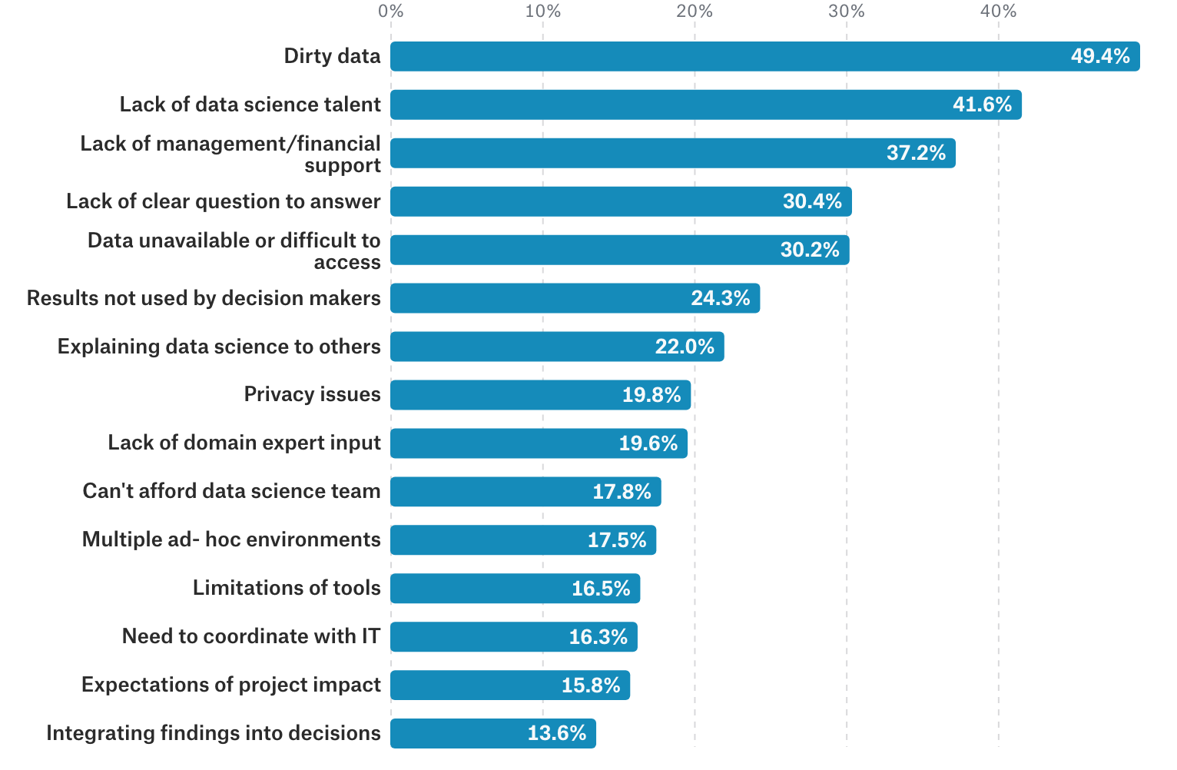
Kaggle 2017 Survey
Barriers

Slide 11
Sample data
My thought process

Slide 12
nih funding data
Research question: gender imbalance in NIH funding outputs
First data set
2009-2017
All funding programs
No variable on seniority
No control of funding type
Current data
1990-2017
Only R01
Controlling for perceived seniority and funding type
Gender classifier
How reliable?

Slide 13
enhancing data through linking multiple data sources
NIH project metadata
Publication-project linkage table
Patent-project linkage table
All provided by NIH ExPORTER
Authoritative but not error-proof
Outliers and typos

Slide 14
practical considerations
Variable format mismatch
For instance, records of 2R01AI011219-44A1, 5R01AI011219-26, and 5R01AI011219-45 are merged into R01AI011219, which include project funding fiscal year, PIs, organizations, project cost, and project duration.
After the merger, we processed all projects in this decision sequence: if a project contains application type “2”, it is grouped into renewed projects (RENEWAL), “3” for competing extension (COMPEXTENSION), “4” and “5” for non-competing extension (NONCOMPEXTENSION), “1” for new projects (NEW). A small number of projects only have the type “6”, “7”, “8”, or “9” which indicates for administrative changes; they are grouped as other (CHANGEONLY).
Preliminary data analysis showed that there were some data anomalies including 26,673 records with $0 funding amount and seven projects with $1 or $2 funding amount and thus they were removed from the data set. Most of these anomalies are projects from the early 1990s.
There are still projects with very low funding size or super long funding period and huge funding size (tens of millions dollars). Are they outliers or errors?

Slide 15
Let’s make sense of the data!
By now, you should have R and RStudio installed

Slide 16
packages we need
oslrr
reshape2
readxl
There are more than 11k packages. What you need probably already exists.

Slide 17
import data
>library(readxl)
>NIHDATA<- read_excel("~/Desktop/output_with_seniority_final.xlsx")

Slide 18
Get a sense of data
>View(NIHDATA)
>summary(NIHDATA)
>mean(NIHDATA$TOTAL_COST)

Slide 19
visualize the relationship between variables
>ggplot(NIHDATA, aes(x=NIHDATA$TOTAL_COST, y=NIHDATA$NUM_PUBLICATIONS))+ geom_point()
>ggplot(NIHDATA, aes(x=NIHDATA$TOTAL_COST, y=NIHDATA$NUM_PUBLICATIONS))+ geom_point()+ geom_smooth(method="lm")

Slide 20
”manipulate” data by truncating axes
g<- ggplot(NIHDATA, aes(x=NIHDATA$TOTAL_COST, y=NIHDATA$NUM_PUBLICATIONS))+ geom_point()+ geom_smooth(method="lm")
g + xlim(c(0, 25000000)) + ylim(c(0, 500))

Slide 21
visualizing categorical data
>ggplot(NIHDATA, aes(x=NIHDATA$IC_NAME)) + geom_bar()+ coord_flip()

Slide 22
using aggregate to process variables
>a<-aggregate(NIHDATA[, 24:25], list(NIHDATA$FY1), mean)

Slide 23
using melt to restructure data so that the group variable is added to the data
>b<-melt(a,id.vars = "Group.1")

Slide 24
plot variables
>ggplot(b, aes(y=b$value,x=b$Group.1,group=b$variable)) + geom_line()+ geom_point()
#adding color
>ggplot(b, aes(y=b$value,x=b$Group.1,group=b$variable)) + geom_line(aes(color=b$variable))+ geom_point(aes(color=b$variable))

Slide 25
know your data before regression
>boxplot(NIHDATA$NUM_PATENTS)
>boxplot(NIHDATA$NUM_PUBLICATIONS)
>hist(NIHDATA$NUM_PATENTS)
>hist(NIHDATA$NUM_PUBLICATIONS)
>cor(NIHDATA$FPIR,NIHDATA$NUM_PUBLICATIONS)

Slide 26
linear regression using logarithmic publication number to smooth the data
>linearModel<- lm(log(NUM_PUBLICATIONS+1) ~ TYPE+FY1+TOTAL_COST+FPIR+R01_MIN_YEAR, data=NIHDATA)
#show results
>summary(linearModel)
#variable selection
>ols_coll_diag(linearModel)

Slide 27
don’t make a decision too quickly…have to look into the context, in this case, it is the NIH institutes
>linearModel<- lm(log(NUM_PUBLICATIONS+1) ~ FY1+TOTAL_COST+PROJECT_MONTHS+FPIR+R01_MIN_YEAR, data=subset(NIHDATA,IC_NAME=="NATIONAL INSTITUTE OF ENVIRONMENTAL HEALTH SCIENCES"))
>summary(linearModel)

